Slide 1
BLENDED LEARNING AND ICT INTEGRATION IN HIGHER EDUCATION
13-3-2019

Slide 2
Agenda
Blended Learning Principles
Establishing Blended Learning Course
1
2
ICT Integration in Higher Education
Active Learning
Quizlet
Kahoot
Canvas (LMS)
3
4
Notes:
ICT Integration in Higher Education

Slide 3
Blended Learning Definition
What is Blended Learning?
Currently, no universal definition exists for blended learning.
Most agree that it involves some combination of online and
face to face instruction.
Blended learning does not occur simply by adding a few online strategies to a traditional classroom. Successful blended learning requires an intentional and integrated approach (Zenger and Uehlein, 2001).
The blend of methods should depend upon the needs of the students and the school.
3
Notes:
Review of the main tasks and goals of the University from the request for information.
Microsoft sees common threads of outreach, inclusion, and participation in these goals. Connecting people and resources in a collaborative and communicative environment.
Currently, no universal definition exists for blended learning.
Most agree that it involves some combination of online and
face to face instruction.
Blended learning does not occur simply by adding a few online strategies to a traditional classroom. Successful blended learning requires an intentional and integrated approach (Zenger and Uehlein, 2001). The blend of methods should depend upon the needs of the students and the school.

Slide 4
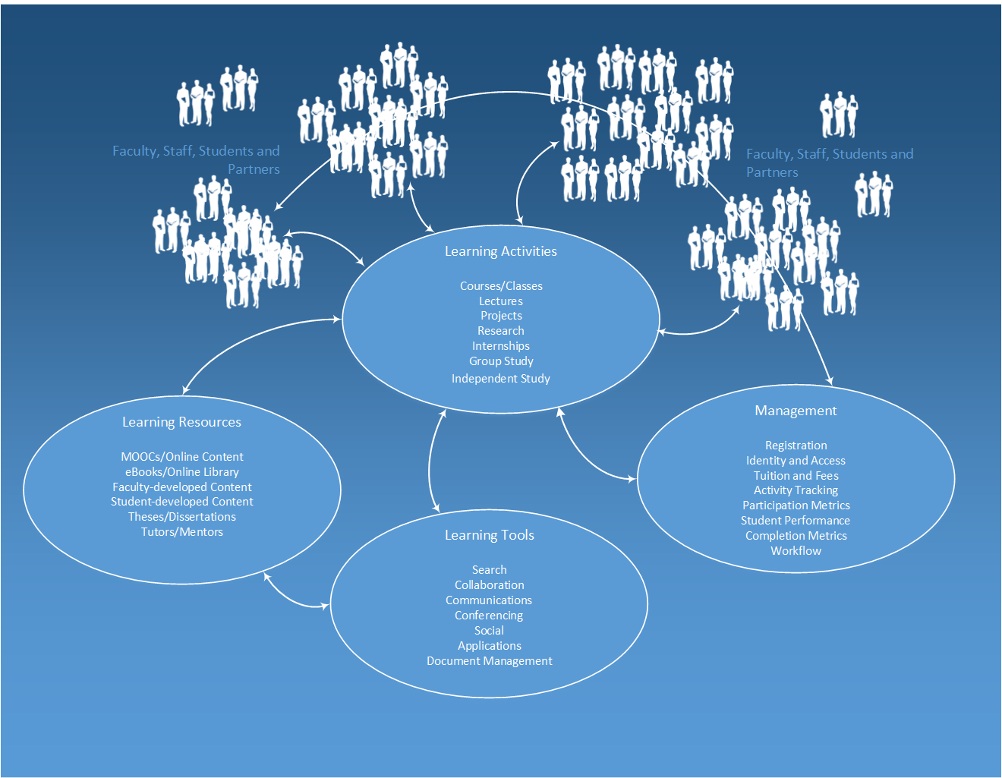
Traditional Learning
4
Notes:
Overview of a modern, digital learning environment.

Slide 5
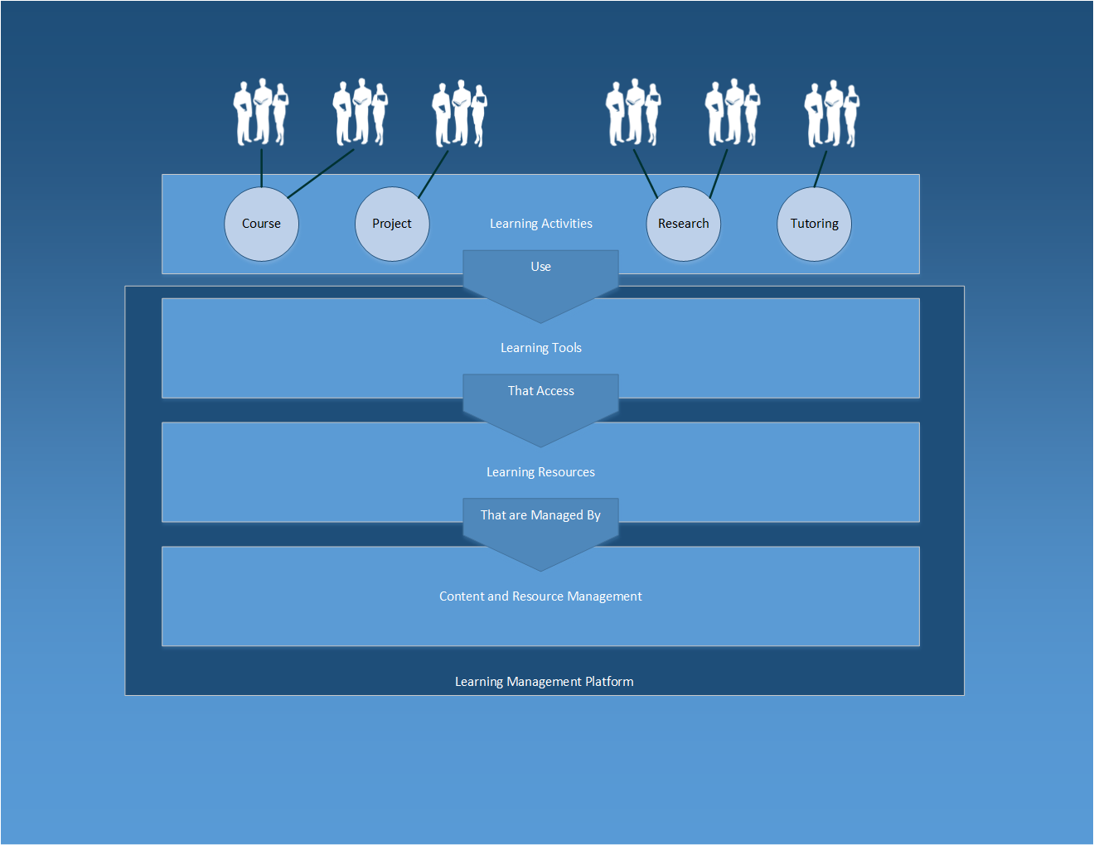
Blended Learning
5
Notes:
Learning activities in a digital learning environment.
People come together in learning activities that may range from traditional in-person classroom settings to global research projects with virtual teams.
These activities may take many forms, but for each activity there is a set of learning tools used to access learning content and resources appropriate to the activity.
Learning resources are mapped to learning activities and managed in the management component.
The learning tools, learning resources and management components are all delivered in the learning and management platform.

Slide 6
Blended Learning Definition
Face-to-Face Learning Experiences
Online
Learning Experiences
Integration
(Do not exceed 35%)
6
Notes:
Summary of the projects described in the request for information.
Many of these projects overlap in terms of the Microsoft platform, some will require partner or other third-party solutions (e.g., student ID cards production).

Slide 7
Why Implement Blended Learning?
Why Implement Blended Learning?
Blended learning allows teachers and schools to address a variety of learning styles with a variation of instructional methods (Wiffin, 2002).
Blended learning frequently provides a higher level of interaction than commonly experienced in face to face courses. (Dziuban, Hartman, & Moskal, 2004; Waddoups & Howell, 2002; Wingard, 2004).
Blended learning practices increase student motivation.
Notes:
Many of the functions described in the University’s projects can be implemented using the Microsoft platform, the platform can be leveraged to create an integrated, role-based user experience.
Some of these functions cross projects, for example the portal, online library, e-learning platform, language laboratory, document sharing and courses online, and workflow can all be implemented using the SharePoint platform.
Video conferencing is supported by Lync.
Microsoft System Center can be used for automated management of applications for multiple computer and device platforms. Windows InTune is a cloud-based service that can be used for device management for a variety of devices.
Security and identity management can be implemented using Microsoft Identity Manager, Active Directory/Azure Active Directory, Active Directory Federation Services, Web Application Gateway, Windows Defender, and Windows Update.
As with most of the solutions that Microsoft has developed for educational institutions, partner products and solutions are a key element. Some project functions such as student ID card production, grid computing integration, and financial market tools will be require third-party products and solutions.

Slide 8
The Impact of B.L. on Student Performance
The Impact of B.L. on Student Performance
Did the blended approach improve student learning?
Did the students feel more prepared for in-class activities after learning the content online?
Did the blended approach increase student participation during the F2F classes?
Did the blended approach increase student interest in the material and overall satisfaction with course?
Kenney, J. & Newcombe, E. (2011). "Adopting a Blended Learning approach: challenges encountered and lessons learned in an action research study.”
Notes:
Many of the functions described in the University’s projects can be implemented using the Microsoft platform, the platform can be leveraged to create an integrated, role-based user experience.
Some of these functions cross projects, for example the portal, online library, e-learning platform, language laboratory, document sharing and courses online, and workflow can all be implemented using the SharePoint platform.
Video conferencing is supported by Lync.
Microsoft System Center can be used for automated management of applications for multiple computer and device platforms. Windows InTune is a cloud-based service that can be used for device management for a variety of devices.
Security and identity management can be implemented using Microsoft Identity Manager, Active Directory/Azure Active Directory, Active Directory Federation Services, Web Application Gateway, Windows Defender, and Windows Update.
As with most of the solutions that Microsoft has developed for educational institutions, partner products and solutions are a key element. Some project functions such as student ID card production, grid computing integration, and financial market tools will be require third-party products and solutions.

Slide 9
General student comments
General student comments
"I learned how to find out and interpret information on my own as well as take information from others"
"I think it teaches responsibility and that we are not always going to be spoon-fed the material”
"Learned time management and self-study skills as a result"
"Improved my computer navigation skills"
"It was a positive experience that I felt increased my knowledge of the area more than a traditional approach"
"I thought it worked well, I was much more prepared for in-class discussion/participation"

Slide 10
Establishing Blended Learning Course
Suggested Online and Face-to-Face Timetable
Course Type | In Class | Online
Sun./Tue./Thu. | Sun & Tue. | Thu.
Mon./Wed. First 4 Weeks | Mon. & Wed. | NONE
Mon./Wed. After Week 4 | Mon. | Wed.
Notes:
Many of the functions described in the University’s projects can be implemented using the Microsoft platform, the platform can be leveraged to create an integrated, role-based user experience.
Some of these functions cross projects, for example the portal, online library, e-learning platform, language laboratory, document sharing and courses online, and workflow can all be implemented using the SharePoint platform.
Video conferencing is supported by Lync.
Microsoft System Center can be used for automated management of applications for multiple computer and device platforms. Windows InTune is a cloud-based service that can be used for device management for a variety of devices.
Security and identity management can be implemented using Microsoft Identity Manager, Active Directory/Azure Active Directory, Active Directory Federation Services, Web Application Gateway, Windows Defender, and Windows Update.
As with most of the solutions that Microsoft has developed for educational institutions, partner products and solutions are a key element. Some project functions such as student ID card production, grid computing integration, and financial market tools will be require third-party products and solutions.

Slide 11
Establishing Blended Learning Course
Syllabus
Notes:
Many of the functions described in the University’s projects can be implemented using the Microsoft platform, the platform can be leveraged to create an integrated, role-based user experience.
Some of these functions cross projects, for example the portal, online library, e-learning platform, language laboratory, document sharing and courses online, and workflow can all be implemented using the SharePoint platform.
Video conferencing is supported by Lync.
Microsoft System Center can be used for automated management of applications for multiple computer and device platforms. Windows InTune is a cloud-based service that can be used for device management for a variety of devices.
Security and identity management can be implemented using Microsoft Identity Manager, Active Directory/Azure Active Directory, Active Directory Federation Services, Web Application Gateway, Windows Defender, and Windows Update.
As with most of the solutions that Microsoft has developed for educational institutions, partner products and solutions are a key element. Some project functions such as student ID card production, grid computing integration, and financial market tools will be require third-party products and solutions.

Slide 12
Establishing Blended Learning Course
Syllabus
Notes:
Many of the functions described in the University’s projects can be implemented using the Microsoft platform, the platform can be leveraged to create an integrated, role-based user experience.
Some of these functions cross projects, for example the portal, online library, e-learning platform, language laboratory, document sharing and courses online, and workflow can all be implemented using the SharePoint platform.
Video conferencing is supported by Lync.
Microsoft System Center can be used for automated management of applications for multiple computer and device platforms. Windows InTune is a cloud-based service that can be used for device management for a variety of devices.
Security and identity management can be implemented using Microsoft Identity Manager, Active Directory/Azure Active Directory, Active Directory Federation Services, Web Application Gateway, Windows Defender, and Windows Update.
As with most of the solutions that Microsoft has developed for educational institutions, partner products and solutions are a key element. Some project functions such as student ID card production, grid computing integration, and financial market tools will be require third-party products and solutions.

Slide 13
Establishing Blended Learning Course
Assessment Breakdown
Midterm Examination | 30 points
Final Examination | 40 points
Blended Learning & In-Class Work | 30 points
Notes:
Many of the functions described in the University’s projects can be implemented using the Microsoft platform, the platform can be leveraged to create an integrated, role-based user experience.
Some of these functions cross projects, for example the portal, online library, e-learning platform, language laboratory, document sharing and courses online, and workflow can all be implemented using the SharePoint platform.
Video conferencing is supported by Lync.
Microsoft System Center can be used for automated management of applications for multiple computer and device platforms. Windows InTune is a cloud-based service that can be used for device management for a variety of devices.
Security and identity management can be implemented using Microsoft Identity Manager, Active Directory/Azure Active Directory, Active Directory Federation Services, Web Application Gateway, Windows Defender, and Windows Update.
As with most of the solutions that Microsoft has developed for educational institutions, partner products and solutions are a key element. Some project functions such as student ID card production, grid computing integration, and financial market tools will be require third-party products and solutions.

Slide 14
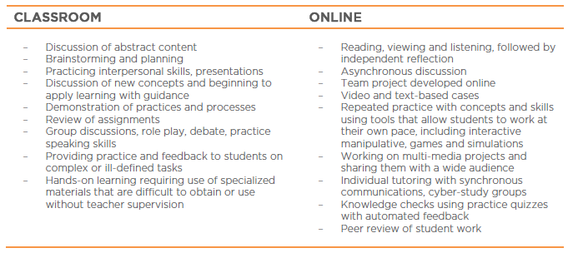
CLASSROOM / ONLINE
CLASSROOM / ONLINE
Notes:
Many of the functions described in the University’s projects can be implemented using the Microsoft platform, the platform can be leveraged to create an integrated, role-based user experience.
Some of these functions cross projects, for example the portal, online library, e-learning platform, language laboratory, document sharing and courses online, and workflow can all be implemented using the SharePoint platform.
Video conferencing is supported by Lync.
Microsoft System Center can be used for automated management of applications for multiple computer and device platforms. Windows InTune is a cloud-based service that can be used for device management for a variety of devices.
Security and identity management can be implemented using Microsoft Identity Manager, Active Directory/Azure Active Directory, Active Directory Federation Services, Web Application Gateway, Windows Defender, and Windows Update.
As with most of the solutions that Microsoft has developed for educational institutions, partner products and solutions are a key element. Some project functions such as student ID card production, grid computing integration, and financial market tools will be require third-party products and solutions.

Slide 15
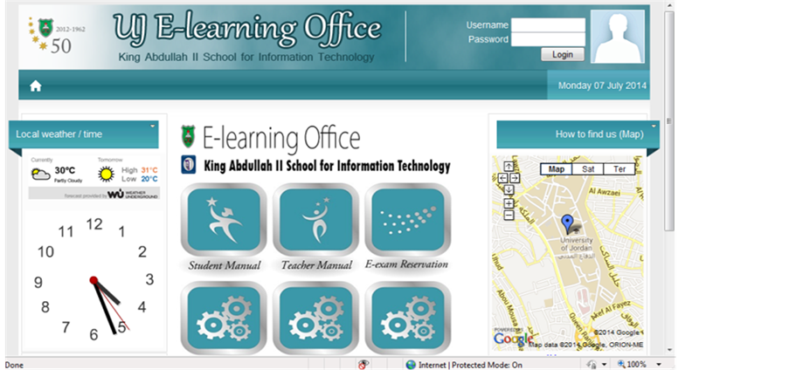
ICT Integration in Higher Education LMS
Notes:
This diagram shows the various Microsoft platform components that can be used to create the learning management platform.

Slide 16
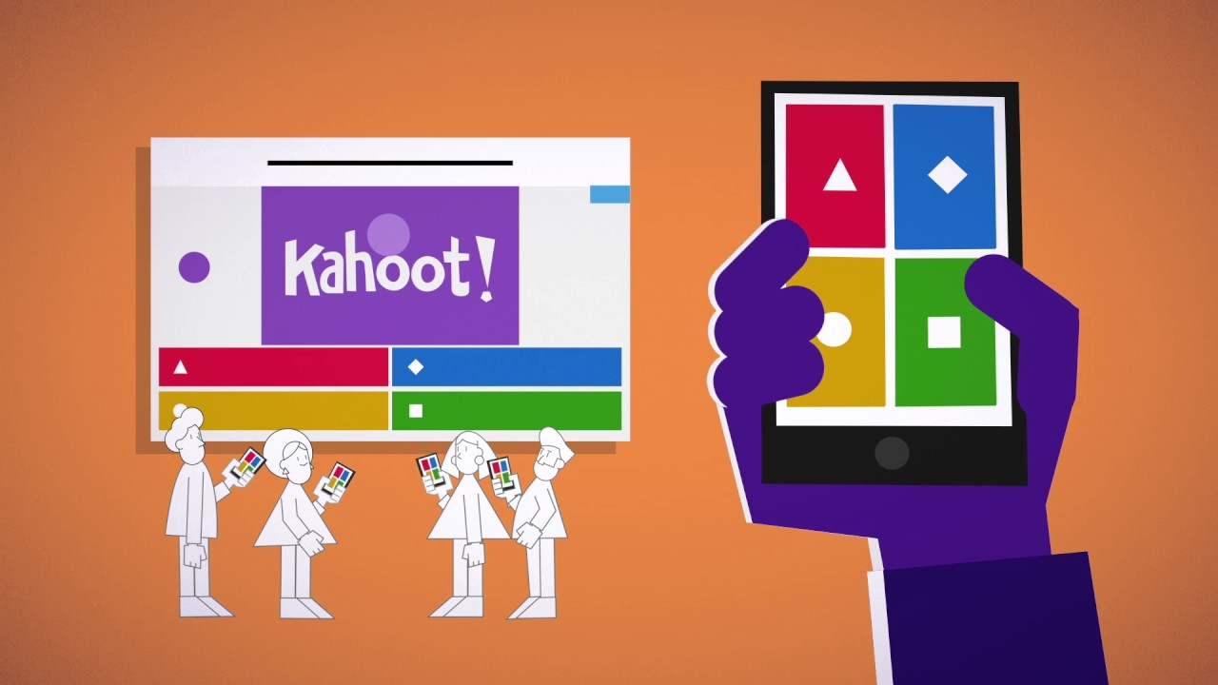
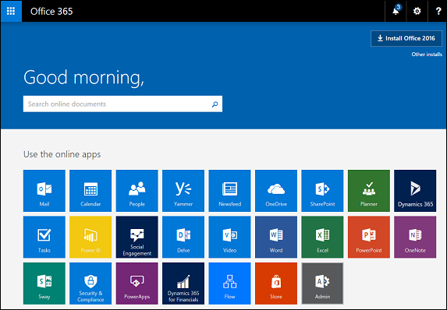
ICT Integration in Higher Education
Notes:
This diagram shows the various Microsoft platform components that can be used to create the learning management platform.

Slide 17
Questions?

